Slide 1

NBA Players Popularity Analysis
Team Members: Daniel, Haarris, Maggie

Slide 2
Project Overview
Our Team was interested in finding out if there is any correlation between NBA Players’ popularity and the wins, NBA Players’ popularity and their twitter counts, NBA Players’ popularity and their salaries, as well as NBA Players’ popularity and their wins.

Slide 3
Data Sources
https://www.kaggle.com/noahgift/social-power-nba
https://en.wikipedia.org/wiki/United_States_men%27s_national_basketball_team
https://www.espn.com/nba/

Slide 4
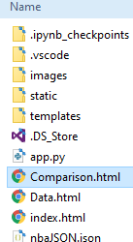
Visualization Tools
Visualization tools used in the project:
BeautifulSoup
D3
Flask
HTML
Pandas
Python
PostgreSQL-json
Jupiter Notebook
Vanilla JavaScript

Slide 5
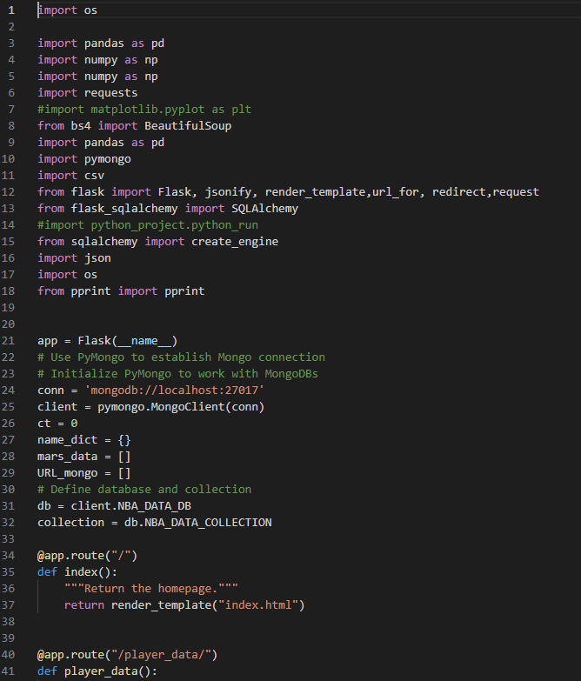
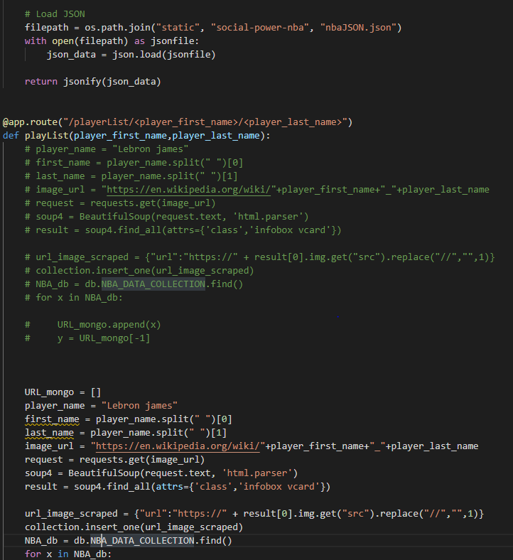
Inside the code

Slide 6
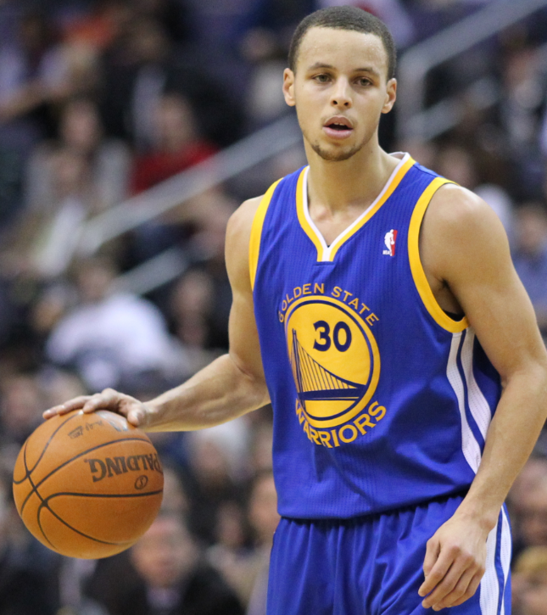
Who is the most popular NBA Player?

Slide 7
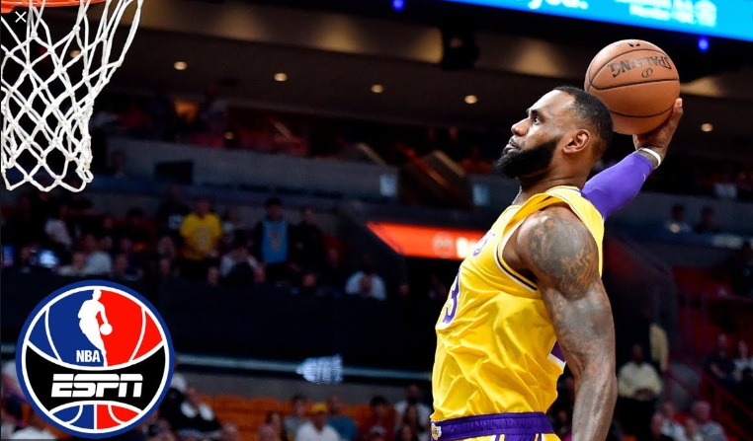
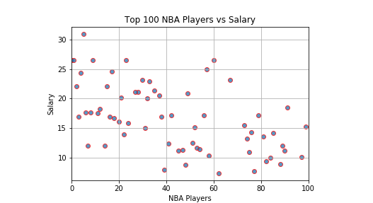
NBA Players’ Popularity and Salaries Analysis
#1 LeBron James ($31M)

Slide 8
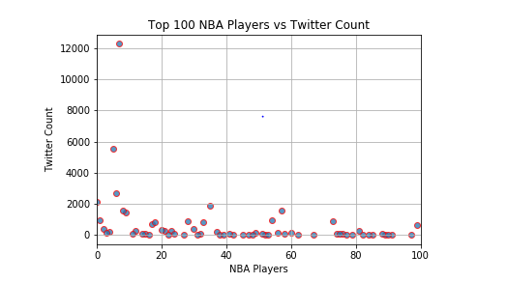
NBA Players’ Popularity and Twitter Counts
#1 Stephen Curry ($12M)

Slide 9
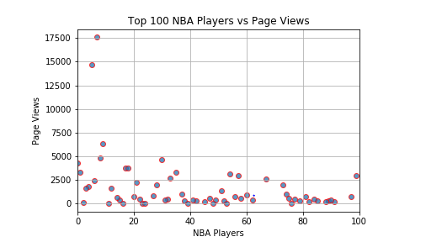
NBA Players’ Popularity and PageViews
#1 Stephen Curry

Slide 10
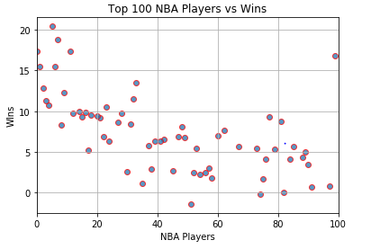
NBA Players’ Popularity and Wins
#1 LeBron James

Slide 11

Conclusion
After we completed the analysis, we came to the surprising conclusion that there was not a significant correlation between NBA Players’ popularity and their wins, NBA Players’ Popularity and their salaries, or the NBA Players’ Salaries and their Twitter count.

Slide 12
Thank you

